Slide 1
Racial Equity Study Fall 2017 Baseline Data
Amanda Brodish
October 18, 2019
Senate Budget Policies Committee

Slide 2
Racial Equity Study
Baseline report on racial equity at Pitt
Focuses on two questions:
How does the racial make-up of (Pgh Campus) Pitt faculty compare to peers?
How do the salaries of underrepresented racial minority (URM) faculty compare to non-URM faculty?

Slide 3
Racial Equity Study
Definitions
URM: includes Black, Hispanic, Two or More Races, American Indian or Alaska Native, or Native Hawaiian or other Pacific Islander
Non-URM: includes White, Asian, Other, or Unknown

Slide 4
1. Racial Make-Up of Pitt Faculty
Question
Is Pitt in line with peers in terms of racial/ethnic make-up of faculty?
Data Source
Department of Education’s IPEDS database

Slide 5
1. Racial Make-Up of Pitt Faculty
Who is included?
4,083 full-time instructional faculty as of Fall 2017
Pittsburgh Campus only
By rank and tenure status
Peers
Association of American Universities (AAU) - Publics
E.g., UVA, University of Michigan, Penn State

Slide 6
1. Racial Make-Up of Pitt Faculty
Analytic Approach
Descriptive stacked bar charts of race/ethnicity data by the combination of rank and tenure status
Race/ethnicity categories include: American Indian or Alaska Native, Asian, Black/African American, Hispanic/Latino, Native Hawaiian or Other Pacific Islander, White, Two or more races, Unknown, Nonresident Alien (i.e., international)

Slide 7
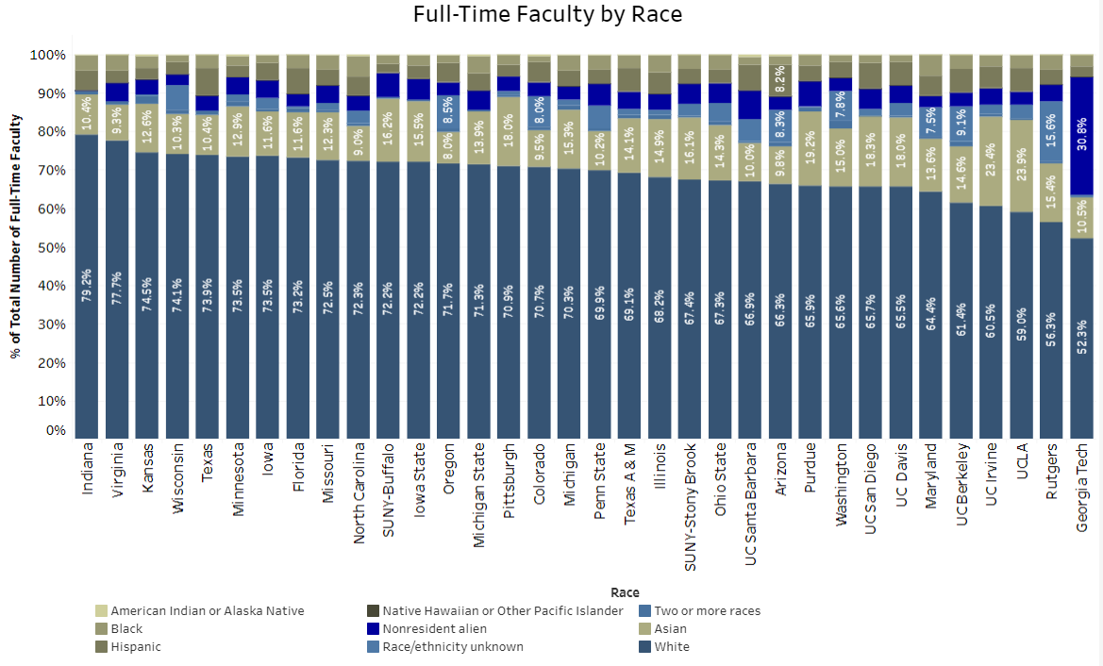

Slide 8
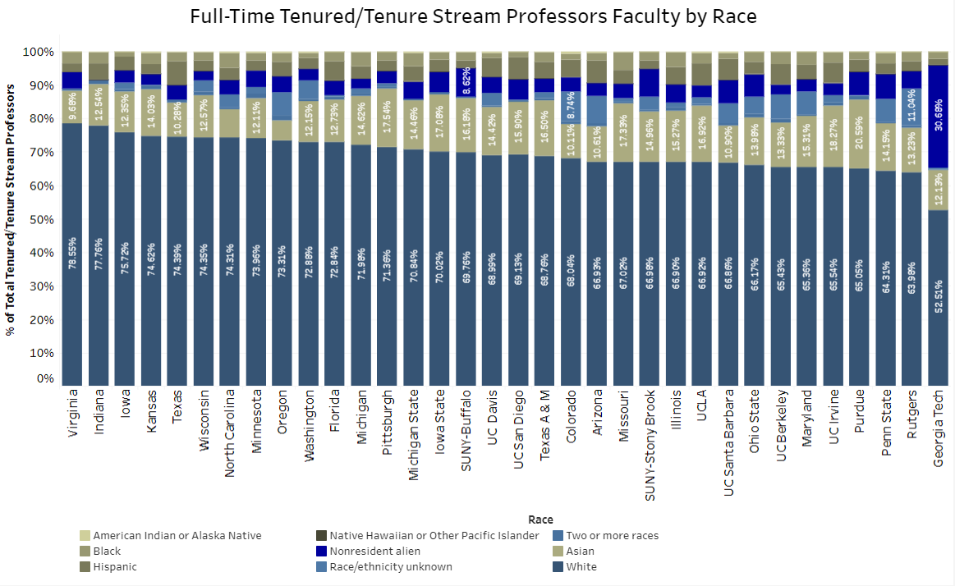

Slide 9
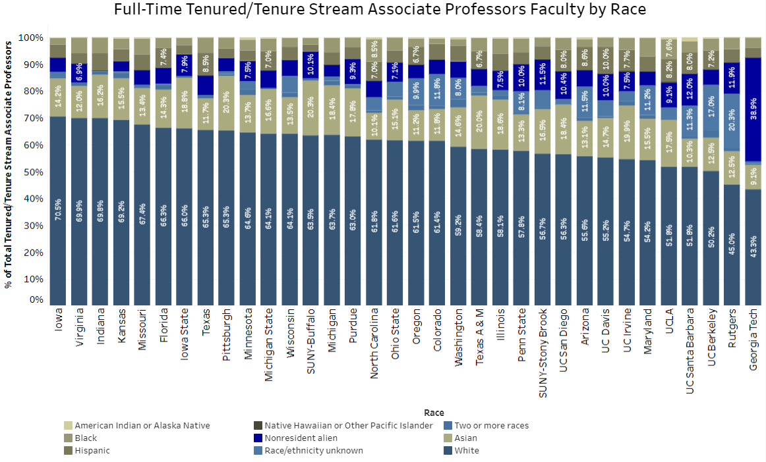

Slide 10
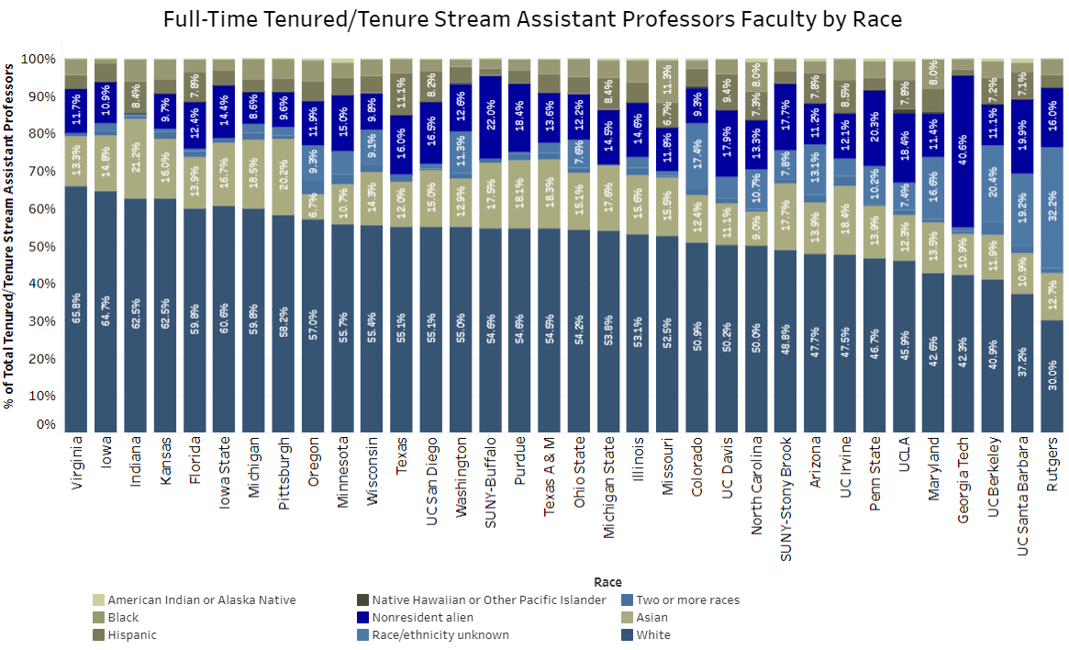

Slide 11
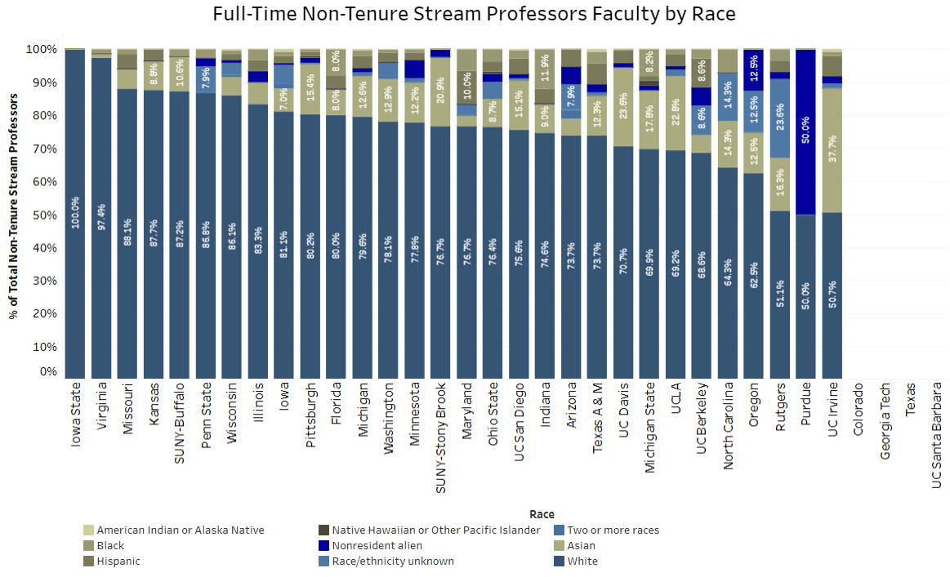

Slide 12
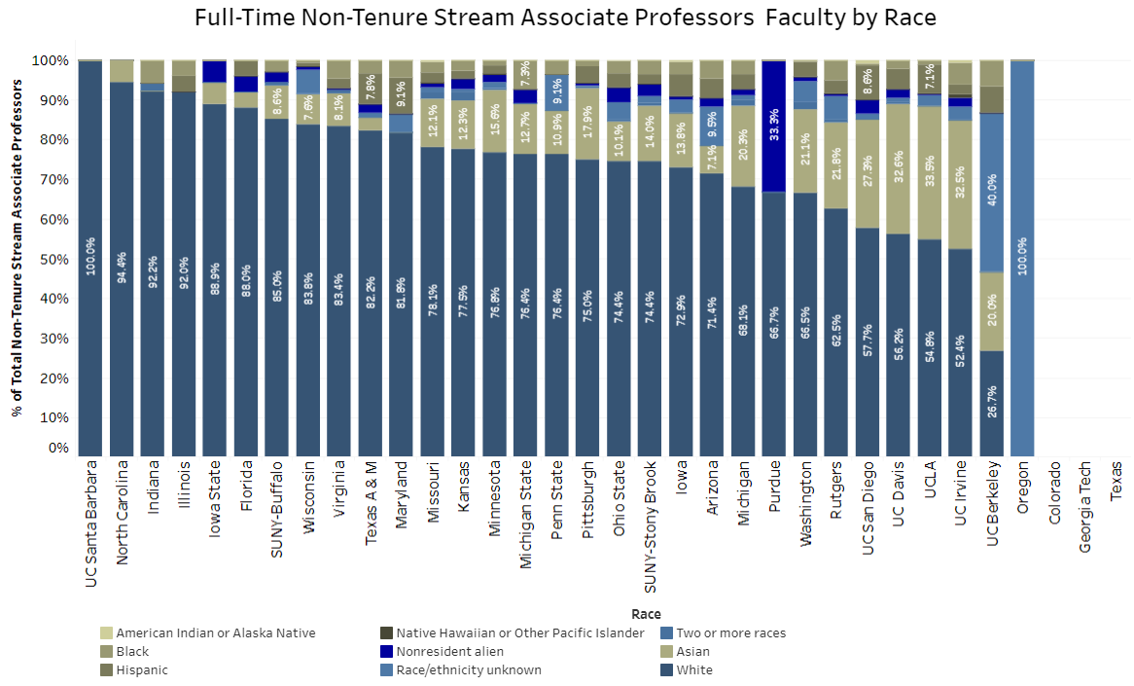

Slide 13
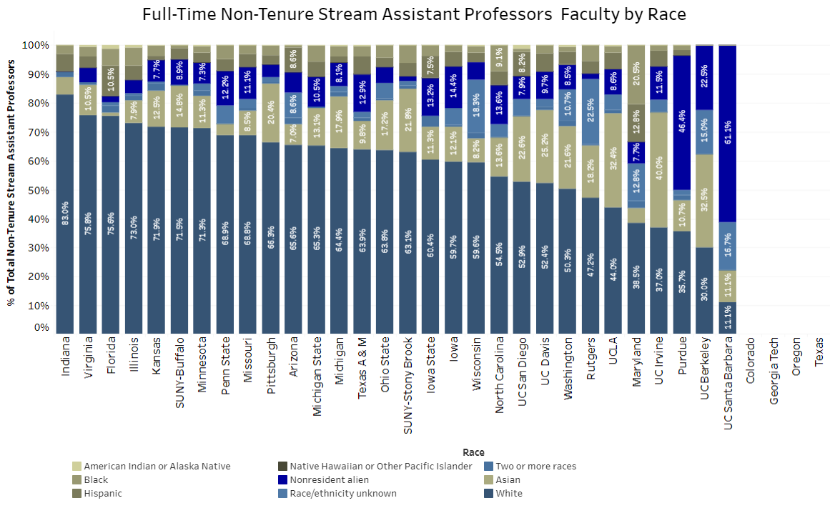

Slide 14
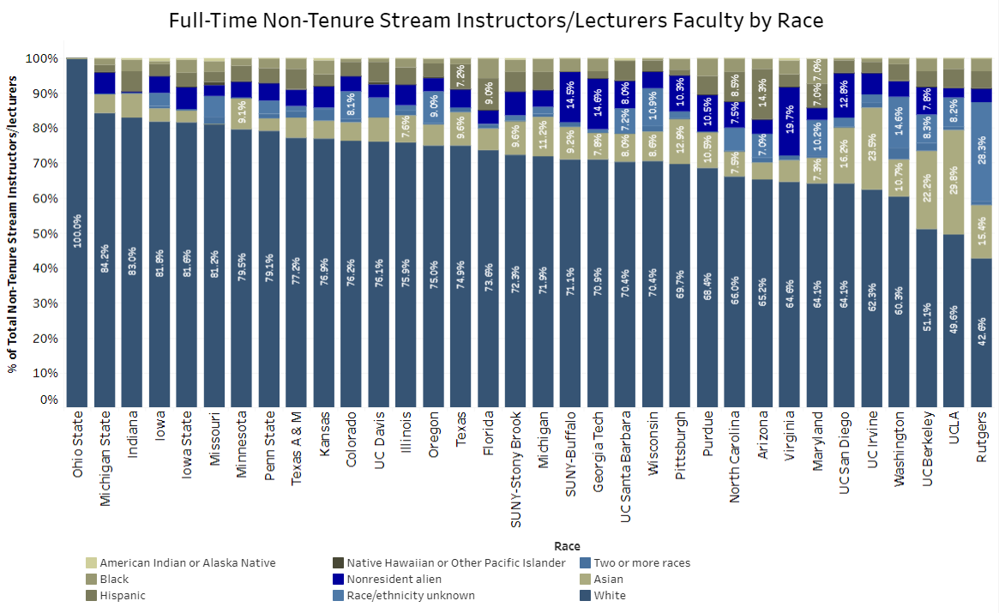

Slide 15
1. Racial Make-Up of Pitt Faculty
Results
Wide variation in racial/ethnic diversity of faculty among peer institutions
Cannot benchmark % URM because of IPEDS racial/ethnic categories
Opportunity for improvement

Slide 16
2. URM vs. Non-URM Salary Analysis
Questions
What is the % URM by rank and tenure-status
How do the salaries of URM faculty compare to non-URM faculty?
Source
University Data Warehouse
Salary data reported to IPEDS

Slide 17
2. URM vs. Non-URM Salary Analysis
Who is included?
Full-time instructional faculty as of Fall 2017
Included faculty with some clinical responsibilities (i.e., UPP)
Excluded primarily clinical faculty (i.e., UPP2, those with majority of pay from UPP)

Slide 18
% of Full-Time Faculty Who are URM: Pittsburgh Campus

Slide 19
% of Full-Time Faculty Who are URM: Regional Campuses

Slide 20
2. URM vs. Non-URM Salary Analysis
Statistical Approach
Regression analyses stratified by rank
Dependent Variable: 9-month equivalent salary
Independent Variable: URM status
Covariates:
Gender
Tenure Status
School (or regional campus)

Slide 21
2. URM vs. Non-URM Salary Analysis
Outcomes
Statistical significance of URM status
Ratio of URM faculty salary to non-URM faculty salary

Slide 22
Regression Analysis: Pittsburgh Campus
 | No Controls
 | Intercept | Estimate | Standard Error | p-value | Salary Ratio
Full Professor | $151,649 | $(5,102) | $9,234 | 0.58 | 97%
Associate Professor | $103,836 | $4,712 | $5,019 | 0.35 | 105%
Assistant Professor | $80,905 | $4,236 | $3,086 | 0.17 | 105%
Instructors & Lecturers | $51,026 | $(227) | $3,116 | 0.94 | 100%

Slide 23
Regression Analysis: Pittsburgh Campus
 | No Controls |  |  |  |  | Controlling for Gender, Tenure Status, & School
 | Intercept | Estimate | Standard Error | p-value | Salary Ratio | Estimate | Standard Error | p-value | Salary Ratio
Full Professor | $151,649 | $(5,102) | $9,234 | 0.58 | 97% | $(5,874) | $8,747 | 0.50 | 96%
Associate Professor | $103,836 | $4,712 | $5,019 | 0.35 | 105% | $3,908 | $4,654 | 0.40 | 104%
Assistant Professor | $80,905 | $4,236 | $3,086 | 0.17 | 105% | $2,526 | $2,575 | 0.32 | 103%
Instructors & Lecturers | $51,026 | $(227) | $3,116 | 0.94 | 100% | $1,027 | $2,832 | 0.72 | 102%

Slide 24
Regression Analysis: Regional Campuses
 | No Controls
 | Intercept | Estimate | Standard Error | p-value | Salary Ratio
Full Professor | $90,587 | $(12,919) | $14,007 | 0.37 | 86%
Associate Professor | $71,880 | $869 | $3,538 | 0.81 | 101%
Assistant Professor | $58,624 | $(2,115) | $5,256 | 0.69 | 96%
Instructors & Lecturers | $48,798 | $624 | $3,294 | 0.85 | 101%

Slide 25
Regression Analysis: Regional Campuses
 | No Controls |  |  |  |  | Controlling for Gender, Tenure Status, & Campus
 | Intercept | Estimate | Standard Error | p-value | Salary Ratio | Estimate | Standard Error | p-value | Salary Ratio
Full Professor | $90,587 | $(12,919) | $14,007 | 0.37 | 86% | $(6,724) | $14,453 | 0.65 | 93%
Associate Professor | $71,880 | $869 | $3,538 | 0.81 | 101% | $335 | $3,537 | 0.93 | 100%
Assistant Professor | $58,624 | $(2,115) | $5,256 | 0.69 | 96% | $(3,863) | $5,105 | 0.45 | 93%
Instructors & Lecturers | $48,798 | $624 | $3,294 | 0.85 | 101% | $2,165 | $3,215 | 0.50 | 104%

Slide 26
2. URM vs. Non-URM Salary Analysis
Results
Salary ratios approach (and exceed) 100% for most ranks across all campuses
Salary ratios are lowest at the professor rank
This finding warrants some detailed exploration

Slide 27
Suggestion for Moving Forward
Combine Gender Equity and Racial Equity Studies into one study
Equity Study would be presented every two years

